Slide 1
NLP

Slide 2
Introduction to NLP
Syntax

Slide 3
Syntax
Is language more than just a “bag of words”?
Grammatical rules apply to categories and groups of words, not individual words.
Example
a sentence includes a subject and a predicate. The subject is a noun phrase and the predicate is a verb phrase.
Noun phrase: The cat, Samantha, She
Verb phrase: arrived, went away, had dinner
When people learn a new word, they learn its syntactic usage.
Examples: wug (n), cluvious (adj) – use them in sentences
Hard to come up with made up words: forkle, vleer, etc. all taken.

Slide 4
Defining Parts of Speech
What do nouns typically have in common?
E.g., can be preceded by “the”.
What about verbs?
Verbs can be preceded by “can’t”.
Adjectives can come between “the” and a noun.
How is this different from grade school definitions?
Determiners
a, the, many, no, five
Prepositions
for, to, in, without, before

Slide 5
The Lexicon
How do we think of words like cat, run, five?
pronunciation, part of speech, meaning
Five: /faɪv/, numeral, “5”
Ambiguity
Notes:
GIVE CREDIT TO UMASS

Slide 6
Constituents
Constituents are continuous
Constituents are non-crossing
if two constituents share one word, then one of them must completely contain the other.
Each word is a constituent

Slide 7
Constituent Tests
“coordination” test
She bought a bagel and three chocolate croissants
“pronoun” test
A small dog is barking in the park.
It is barking in the park
“question by repetition” test:
I have seen blue elephants
Blue elephants?
* Seen blue?
Seen blue elephants?
“topicalization” test:
Blue elephants, I have seen.
“question” test:
What have I seen?
“deletion” test
Last year I saw a blue elephant in the zoo.
“semantic” test
“intuitition” test

Slide 8
How to generate sentences
One way: tree structure
Generate the tree structure first
Then fill the leaf nodes with terminals
Notes:
Norvig code

Slide 9
A Simple Syntactic Rule
The simplest rule for a sentence, e.g. “Birds fly”
S → N V

Slide 10
Simplest Grammar
S → N V
N → Samantha | Min | Jorge
V → left | sang | walked
Sample sentences:
Samantha sang
Jorge left
Notes:
Norvig code

Slide 11
Syntax
The verbs so far were intransitive (no direct object)
What rules are needed next?
Transitive verbs and direct objects (“Jorge saw Samantha”)
Determiners (“the cats”)
Combinatorial explosion (even for the simplest form of sentences)
Need for noun phrases
Ditto for verb phrases

Slide 12
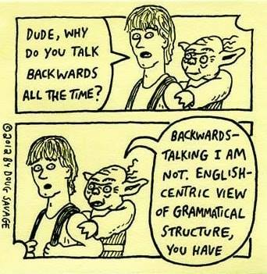

Slide 13
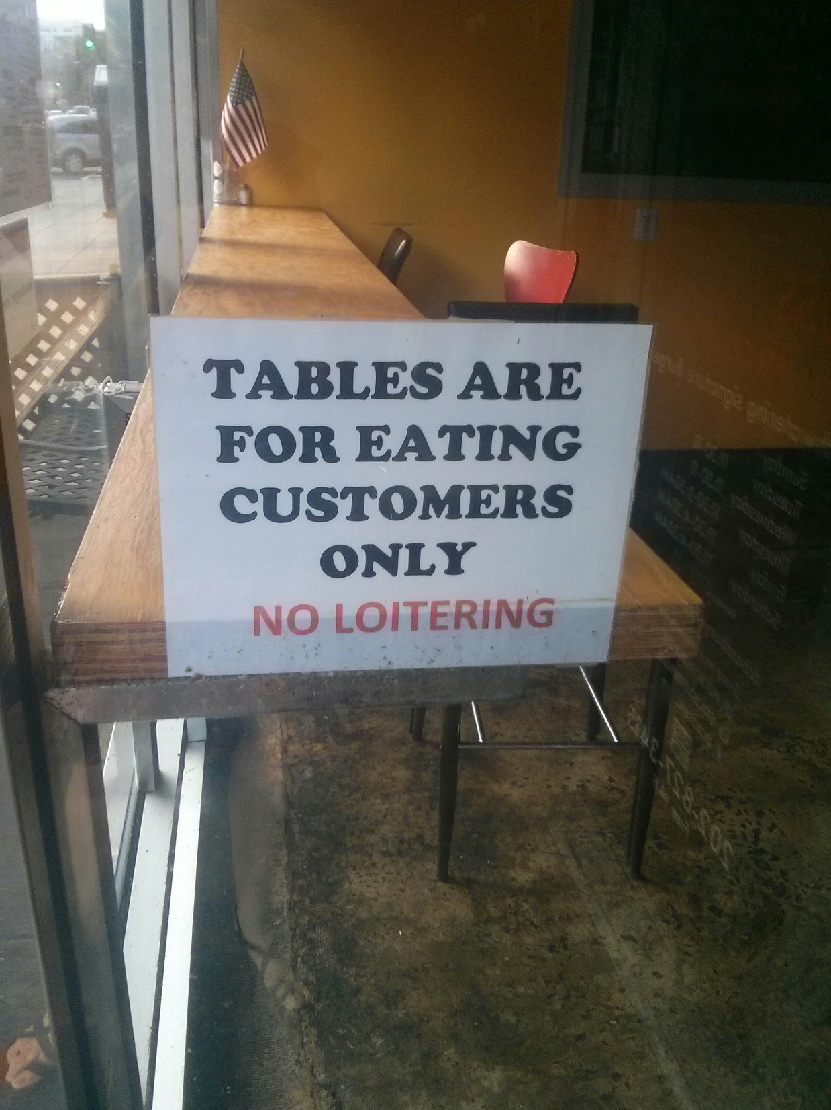

Slide 14
Latest Grammar
S → NP VP
NP → DT N
VP → V NP
DT → the | a
N → child | cat | dog
V → took | saw | liked | scared | chased
Sample sentences:
a dog chased the cat
the child saw a dog
Notes:
Norvig code

Slide 15
Alternatives
Different expansions of a category are delineated with ”|”
NP → PN | DT CN
One rule for proper nouns and another for common nouns

Slide 16
Latest Grammar
S → NP VP
NP → DT CN
NP → PN
VP → V NP
DT → the | a
CN → child | cat | dog
PN → Samantha | Jorge | Min
V → took | saw | liked | scared | chased
Sample sentences:
a child scared Jorge
Min took the child
Notes:
Norvig code

Slide 17
Optional categories
Wherever N is allowed in a sentence,
DT N
JJ N
DT JJ N
are also allowed
We can use the notation for alternatives
NP → N | DT N | JJ N | DT JJ N
Optional categories can be also marked using parentheses:
NP → (DT) (JJ) N

Slide 18
Verb Phrases
Samantha ran.
Samantha ran to the park.
Samantha ran away.
Samantha bought a cookie.
Samantha bought a cookie for John.
Overall structure
VP → V(NP)(P)(NP)

Slide 19
Latest Grammar
S → NP VP
NP → DT CN
NP → PN
VP → V (NP) (P) (NP)
DT → the | a
CN → child | cat | dog
PN → Samantha | Jorge | Min
P → to | for | from | in
V → took | saw | liked | scared | chased | gave
Sample sentences:
Samantha saw the cat
Jorge gave the cat to Min
Notes:
Norvig code

Slide 20
Prepositional Phrases
Examples:
Mary bought a book for John in a bookstore.
The bookstore sells magazines.
The bookstore on Main St. sells magazines.
Mary ran away.
Mary ran down the hill.
Changes are needed to both NP and VP to accommodate prepositional phrases
Wherever a preposition is allowed, it can be followed by a noun phrase.
Run up
NP can contain any number of PPs but only up to two NPs.
How do we revise the grammar accordingly?

Slide 21
The Rules So Far
S → NP VP
NP → (DT) (JJ) N (PP)
VP → V (NP) (PP)
PP → P (NP)

Slide 22
PP Ambiguity
The boy saw the woman with the telescope.
PP → PREP NP
VP → V NP PP
VP → V NP
NP → DT N
NP → DT N PP

Slide 23
Repetition (*)
(JJ*) = a sequence of zero or more JJ
Are all sequences of adjectives allowed?
a big red house
* a red big house
Adjective ordering in English depends on semantics!

Slide 24
Exercise
The Little Red Riding Hood
Three Little Pigs
The Three Musketeers
The Steadfast Tin Soldier
The French Connection
Old Macdonald
Five Golden Rings
The Ancient Mariner

Slide 25
Adjective ordering
Det
Number
Strength
Size
Age
Shape
Color
Origin
Material
Purpose
Noun
det < number < size < color < purpose < noun
strength < material < noun
origin < noun
Notes:
REMOVE

Slide 26
Nested Sentences
Examples:
I don’t recall whether I took the dog out.
Do you know if the mall is still open?
VP → V (NP) (NP) (C S) (PP*)
Can (C S) appear inside an NP?
Whether he will win the elections remains to be seen.

Slide 27
Recursion
S can generate VP, VP can generate S
NP can generate PP, PP can generate NP
What does recursion allow?
Is there a longest sentence in English?
Conjunction of NPs:
NP → NP and NP
Conjunction of PPs:
PP → PP and PP
Conjunction of VPs:
VP → VP and VP

Slide 28
Meta-patterns
S → NP VP
NP → (DT) (JJ) N (PP)
VP → V (NP) (PP)
PP → P (NP)
Is there a meta-pattern here?
XP → (specifier) X’
X’ → X (complement)
Example: NP → DT N’
X-bar Theory
http://www.unlweb.net/wiki/X-bar_theory
Notes:
X’ → X (complement) -- in English; In Japanese – inverse

Slide 29
Meta-rules for Conjunctions
Conjunction
X → X and X
This kind of rule even covers entire sentences
S → S and S

Slide 30
Auxiliaries
Is “Aux V” a constituent?
I have seen blue elephants and will remember them forever.
Recursion:
VP -> Aux VP
Raj may have been sleeping.
Is such recursion unlimited?
Notes:
Provenance?

Slide 31
Exercise
Grammar:
S → NP VP | CP VP
NP → (DT) (JJ*) N (CP) (PP*)
VP → V (NP) (NP) (PP*) | V (NP) (CP) (PP*)
PP → P NP
CP → C S
What rules are needed to generate these three sentences:
1. The small dog of the neighbors brought me an old tennis ball.
2. That wugs have three eyes is unproven by scientists.
3. I saw the gift that the old man gave me at the meeting.
Notes:
CHECK PROVENANCE

Slide 32
Notes
Syntax helps with sentences like
* The milk drank the cat
The milk is drunk by the cat
Overgeneration
The girl saw
Undergeneration
Grammar – between the two

Slide 33
Arguments vs. Adjuncts
Arguments
Mandatory (e.g., “* Romeo likes”, “*likes Juliet”)
Cannot be repeated (e.g., “* Juliet likes Romeo John”)
Verbs can have more than one subcategorization frame
Adjuncts
Optional
Typically prepositional phrases or adverbs
Can be repeated (e.g., “Apparently Candace ate pizza yesterday at the restaurant with pleasure”)
Notes:
CHECK PROVENANCE

Slide 34
NLP

